Slide 1
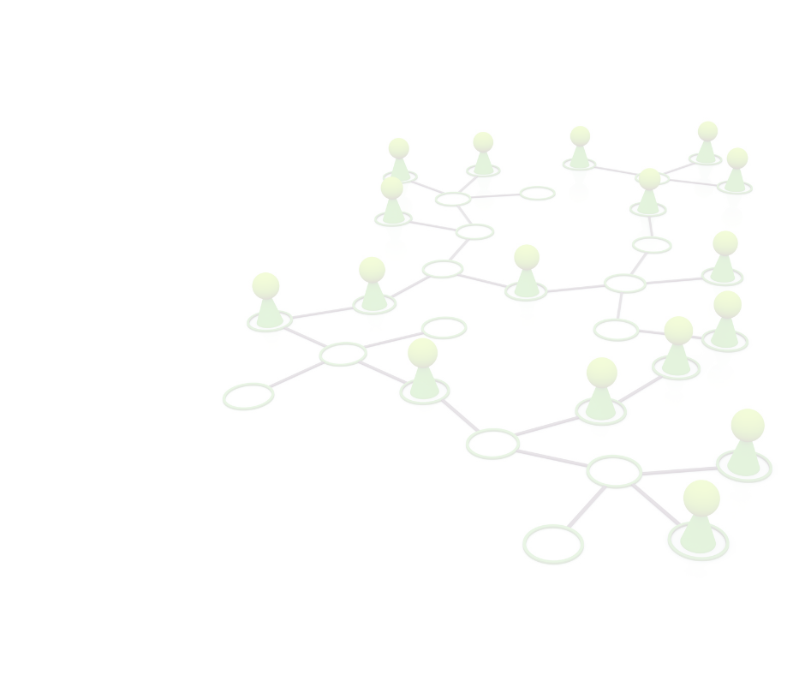
Blended CareerBOT Training
Module 1: Digital Transformation & Green Jobs
Funded by the European Union. Views and opinions expressed are however those of the author(s) only and do not necessarily reflect those
of the European Union or OeAD-GmbH. Neither the European Union nor the granting authority can be held responsible for them.

Slide 2
AGENDA
Module 1 consists of 2 Learning Units with this content:
Learning Unit 1: Digitalisation in Europe: Opportunities, Challenges, and Impacts
Europe‘s Digital Revolution?
The European Way of Digitalisation
Challenges for Europe
Learning Unit 2: Green Jobs in Europe: New Demands and Opportunities
The Green Economy in Europe
A European Green Deal
Skills required for green jobs
Funded by the European Union. Views and opinions expressed are however those of the author(s) only and do not necessarily reflect those
of the European Union or OeAD-GmbH. Neither the European Union nor the granting authority can be held responsible for them.

Slide 3
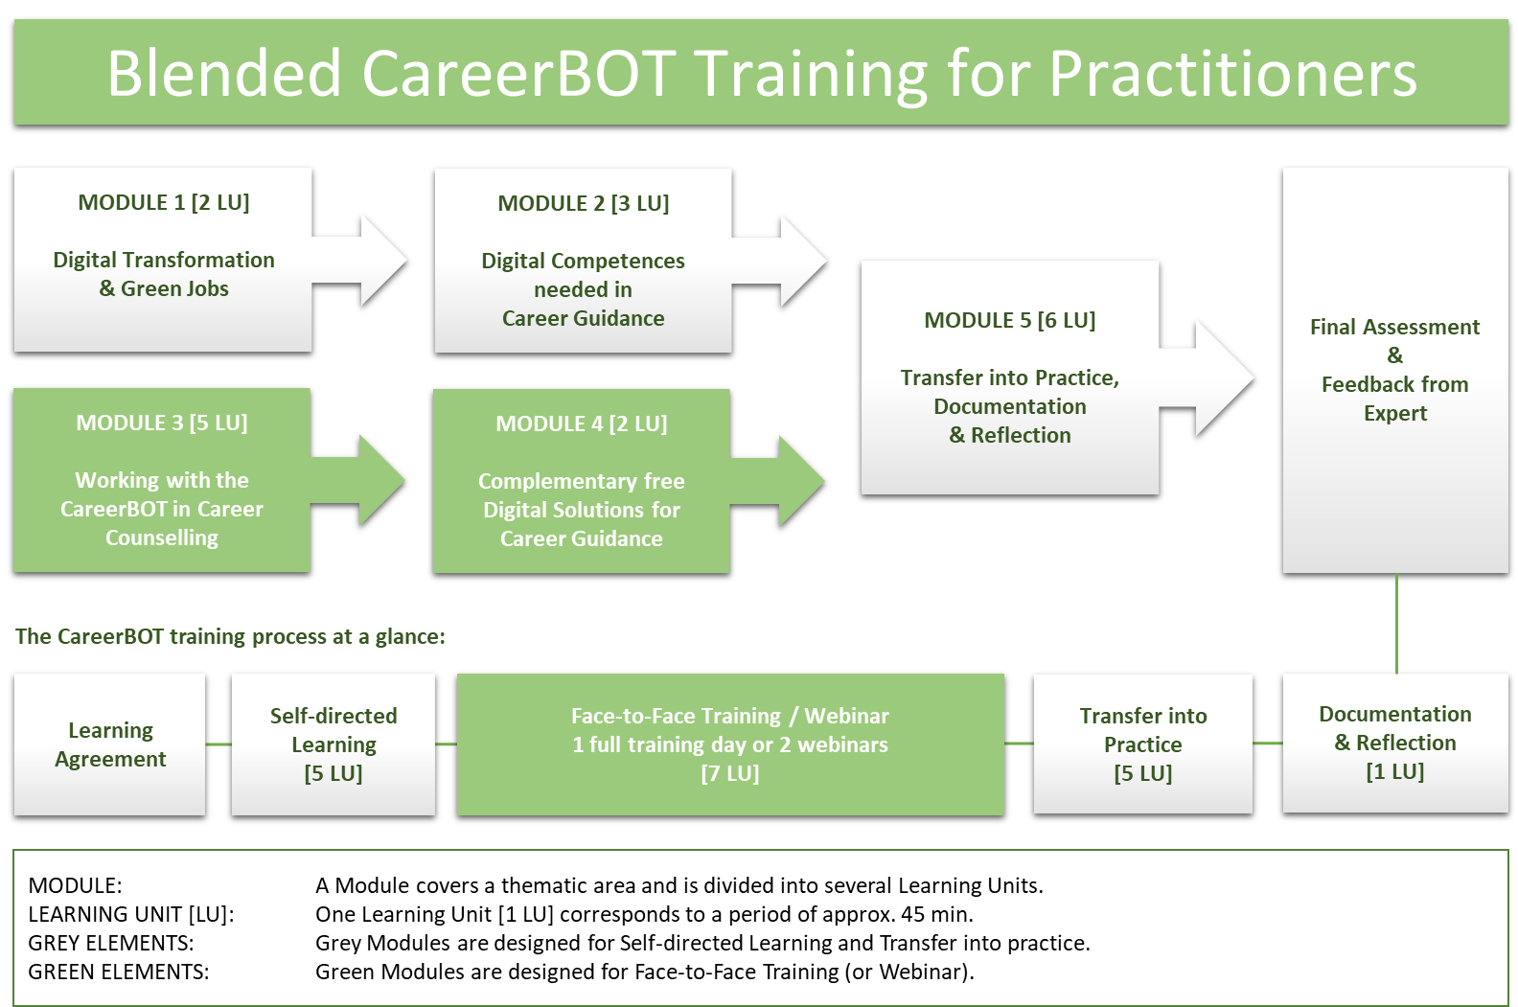
CareerBot Training for practitioners
Funded by the European Union. Views and opinions expressed are however those of the author(s) only and do not necessarily reflect those
of the European Union or OeAD-GmbH. Neither the European Union nor the granting authority can be held responsible for them.

Slide 4
Learning Unit 1
Let‘s explore LU 1:
Digitalisation in Europe: Opportunities, Challenges, and Impacts
#digital revolution, #digital europe programme, #digitaleurope, #eurofound digitalisation, #challenges, #frameworks & policies
Funded by the European Union. Views and opinions expressed are however those of the author(s) only and do not necessarily reflect those
of the European Union or OeAD-GmbH. Neither the European Union nor the granting authority can be held responsible for them.

Slide 5
LU1: Learning Outcomes
Learners gain a comprehensive understanding of digitalisation's profound impact on Europe:
Impact of Digitalisation – Europe’s Digital Revolution?
Global Positioning – The European Way
5 Initiatives on Digitalisation on European Level
Challenges in Digitalisation for Europe
Policies and Frameworks – a selection
Funded by the European Union. Views and opinions expressed are however those of the author(s) only and do not necessarily reflect those
of the European Union or OeAD-GmbH. Neither the European Union nor the granting authority can be held responsible for them.
Notes:
LEARNING OUTCOMES OF THE MODULE:
The learners got a first insight of the current developments in the field of digitalisation and green jobs on European level, are able to do further research for their own countries and can apply this knowledge in their counselling sessions. Practitioners know where to find further sources and information on the themes of Digitalisation and Green Jobs and are equipped with a kind of "reference book" that accompanies them through the CareerBot training.
Learning Unit 1: Digitalisation in Europe: Opportunities, Challenges, and Impacts
Learners gained a comprehensive understanding of digitalisation's profound impact on Europe, from societal and economic transformations to governance and sustainability. They are equipped with insights into Europe's global positioning, the challenges and opportunities digitalisation presents, and the EU's ambitious digital strategy.
Impact of Digitalisation: Practitioners know how Digitalisation transforms European society, economy, and governance, reshaping how people live, work, and connect. It influences information access, business models, and data-driven governance.
Global Positioning: Learners now understand that Europe's strategic role in the global digital landscape is vital for competitiveness, innovation, and digital independence.
Challenges and Opportunities: Learners have explored the challenges associated with digitalisation, such as digital disparities and skills gaps. They have also identified the numerous opportunities it presents, including economic growth, enhanced productivity, and sustainability.
EU's Digital Strategy: Learners are now familiar with the European Union's ambitious digital strategy. This strategy encompasses goals like achieving digital sovereignty, setting independent standards, attaining carbon neutrality by 2050, ensuring online safety, promoting fair digital markets, strengthening tech competitiveness, enabling individual data control, harnessing the potential of artificial intelligence (AI), and establishing secure European data spaces.
Digitalisation and Economic Growth: Learners have recognized the profound link between digitalisation and economic growth. Digital technologies drive growth by increasing productivity, reducing operational costs, and fostering innovation across various industries.
Digitalisation for Sustainability: Learners understand the role of digitalisation in advancing sustainability in Europe. It achieves this by transforming business models, reducing greenhouse gas emissions, supporting clean and sustainable energy sources, and enhancing resource management. This aligns with the objectives of the European Green Deal.

Slide 6
LU1: Impact of Digitalisation
Digitalisation has become a significant driving force in Europe, reshaping various aspects of society, economy, and governance.
Europe's Digital Revolution? While there has been progress in the adoption of digital technologies by firms in the European Union, it has not yet closed the gap with the United States. (European Investment Bank. 2021)
Although most European countries are progressing in their digital transformation efforts, there exists considerable variation in the adoption of key digital technologies by businesses among different nations. (Smart Energy International. 2021)
The EU's digital strategy is focused on harnessing the potential of digital transformation for the benefit of individuals and businesses. (European Investment Bank. 2023)
Funded by the European Union. Views and opinions expressed are however those of the author(s) only and do not necessarily reflect those
of the European Union or OeAD-GmbH. Neither the European Union nor the granting authority can be held responsible for them.

Slide 7
LU1: Positioning – The European Way
Following the European Commission and related European Agencies, the European way to a digitalised economy and society is about solidarity, prosperity and sustainability, anchored in empowerment of its citizens and businesses, ensuring the security and resilience of its digital ecosystem and supply chains. EC priorities are:
European Digital Strategy 2020–2025: Launched in February 2020, the Strategy aims to empower people with a new generation of technologies, helping to support the ‘just transition’ to a climate-neutral Europe via the European Green Deal.
As part of its Digital Services Act package, published on 15 December 2020, the Commission proposed two legislative initiatives to upgrade rules governing digital services in the EU: the Digital Services Act (DSA) and the Digital Markets Act (DMA). These initiatives will change the way companies offer and use digital services.
Digitalisation in Europe presents both opportunities and challenges. Here are the sources we want to present to Practitioners, working with the CareerBot to get an understanding of ongoing and planned activities on European level focussing on the opportunities:
Funded by the European Union. Views and opinions expressed are however those of the author(s) only and do not necessarily reflect those
of the European Union or OeAD-GmbH. Neither the European Union nor the granting authority can be held responsible for them.

Slide 8
LU1: 5 Initiatives on Digitalisation in EU
1. A Europe fit for the digital age
Empowering people with a new generation of technologies: Digital technology is revolutionizing the way people lead their lives. The European Union's digital strategy is committed to harnessing this transformation for the benefit of individuals and enterprises, all while contributing to the ambitious goal of achieving a carbon-neutral Europe by 2050.
Website: https://ec.europa.eu/info/strategy/priorities-2019-2024/europe-fit-digital-age_en
YouTube link: https://www.youtube.com/watch?v=wU6PQL3lZxs
Funded by the European Union. Views and opinions expressed are however those of the author(s) only and do not necessarily reflect those
of the European Union or OeAD-GmbH. Neither the European Union nor the granting authority can be held responsible for them.
Notes:
LEARNING OUTCOMES OF THE MODULE:
The learners got a first insight of the current developments in the field of digitalisation and green jobs on European level, are able to do further research for their own countries and can apply this knowledge in their counselling sessions. Practitioners know where to find further sources and information on the themes of Digitalisation and Green Jobs and are equipped with a kind of "reference book" that accompanies them through the CareerBot training.
Learning Unit 1: Digitalisation in Europe: Opportunities, Challenges, and Impacts
Learners gained a comprehensive understanding of digitalisation's profound impact on Europe, from societal and economic transformations to governance and sustainability. They are equipped with insights into Europe's global positioning, the challenges and opportunities digitalisation presents, and the EU's ambitious digital strategy.
Impact of Digitalisation: Practitioners know how Digitalisation transforms European society, economy, and governance, reshaping how people live, work, and connect. It influences information access, business models, and data-driven governance.
Global Positioning: Learners now understand that Europe's strategic role in the global digital landscape is vital for competitiveness, innovation, and digital independence.
Challenges and Opportunities: Learners have explored the challenges associated with digitalisation, such as digital disparities and skills gaps. They have also identified the numerous opportunities it presents, including economic growth, enhanced productivity, and sustainability.
EU's Digital Strategy: Learners are now familiar with the European Union's ambitious digital strategy. This strategy encompasses goals like achieving digital sovereignty, setting independent standards, attaining carbon neutrality by 2050, ensuring online safety, promoting fair digital markets, strengthening tech competitiveness, enabling individual data control, harnessing the potential of artificial intelligence (AI), and establishing secure European data spaces.
Digitalisation and Economic Growth: Learners have recognized the profound link between digitalisation and economic growth. Digital technologies drive growth by increasing productivity, reducing operational costs, and fostering innovation across various industries.
Digitalisation for Sustainability: Learners understand the role of digitalisation in advancing sustainability in Europe. It achieves this by transforming business models, reducing greenhouse gas emissions, supporting clean and sustainable energy sources, and enhancing resource management. This aligns with the objectives of the European Green Deal.

Slide 9
LU1: 5 Initiatives on Digitalisation in EU
2. The Digital Europe Programme (DIGITAL)
Website: https://digital-strategy.ec.europa.eu/en/activities/digital-programme
YouTube link: https://www.youtube.com/watch?v=_VkzyMgjD4E
is an EU funding programme that aims to bring digital technology to businesses, citizens, and public administrations. It supports projects in five key capacity areas: supercomputing, artificial intelligence, cybersecurity, advanced digital skills, and ensuring a wide use of digital technologies across the economy and society.
Funded by the European Union. Views and opinions expressed are however those of the author(s) only and do not necessarily reflect those
of the European Union or OeAD-GmbH. Neither the European Union nor the granting authority can be held responsible for them.
Notes:
LEARNING OUTCOMES OF THE MODULE:
The learners got a first insight of the current developments in the field of digitalisation and green jobs on European level, are able to do further research for their own countries and can apply this knowledge in their counselling sessions. Practitioners know where to find further sources and information on the themes of Digitalisation and Green Jobs and are equipped with a kind of "reference book" that accompanies them through the CareerBot training.
Learning Unit 1: Digitalisation in Europe: Opportunities, Challenges, and Impacts
Learners gained a comprehensive understanding of digitalisation's profound impact on Europe, from societal and economic transformations to governance and sustainability. They are equipped with insights into Europe's global positioning, the challenges and opportunities digitalisation presents, and the EU's ambitious digital strategy.
Impact of Digitalisation: Practitioners know how Digitalisation transforms European society, economy, and governance, reshaping how people live, work, and connect. It influences information access, business models, and data-driven governance.
Global Positioning: Learners now understand that Europe's strategic role in the global digital landscape is vital for competitiveness, innovation, and digital independence.
Challenges and Opportunities: Learners have explored the challenges associated with digitalisation, such as digital disparities and skills gaps. They have also identified the numerous opportunities it presents, including economic growth, enhanced productivity, and sustainability.
EU's Digital Strategy: Learners are now familiar with the European Union's ambitious digital strategy. This strategy encompasses goals like achieving digital sovereignty, setting independent standards, attaining carbon neutrality by 2050, ensuring online safety, promoting fair digital markets, strengthening tech competitiveness, enabling individual data control, harnessing the potential of artificial intelligence (AI), and establishing secure European data spaces.
Digitalisation and Economic Growth: Learners have recognized the profound link between digitalisation and economic growth. Digital technologies drive growth by increasing productivity, reducing operational costs, and fostering innovation across various industries.
Digitalisation for Sustainability: Learners understand the role of digitalisation in advancing sustainability in Europe. It achieves this by transforming business models, reducing greenhouse gas emissions, supporting clean and sustainable energy sources, and enhancing resource management. This aligns with the objectives of the European Green Deal.

Slide 10
LU1: 5 Initiatives on Digitalisation in EU
3. DIGITALEUROPE - A STRONGER DIGITAL EUROPE
Website: https://www.digitaleurope.org/policies/strongerdigitaleurope/
YouTube link: https://www.youtube.com/watch?v=im1zIyqxBGg&t=25s
DIGITALEUROPE is a trade association that represents the digital technology industry in Europe. They have published a call to action towards 2025 that outlines their vision for a stronger digital Europe. Their resources cover topics such as digital skills, innovation, and sustainability.
Funded by the European Union. Views and opinions expressed are however those of the author(s) only and do not necessarily reflect those
of the European Union or OeAD-GmbH. Neither the European Union nor the granting authority can be held responsible for them.

Slide 11
LU1: 5 Initiatives on Digitalisation in EU
4. Eurofound: Digitalisation
Website: https://www.eurofound.europa.eu/topic/digitalisation
YouTube link: https://www.youtube.com/watch?v=lEB9mMm74Fs
Eurofound is a European Union agency that provides research and analysis on social and work-related issues. Their website has a section on digitalisation that covers topics such as the impact of digitalisation on employment, skills, and working conditions.
Funded by the European Union. Views and opinions expressed are however those of the author(s) only and do not necessarily reflect those
of the European Union or OeAD-GmbH. Neither the European Union nor the granting authority can be held responsible for them.

Slide 12
LU1: 5 Initiatives on Digitalisation in EU
5. The Organisation for Economic Co-operation and Development (OECD)
Website: https://www.oecd.org/trade/topics/digital-trade/
OECD has a section on digital trade that covers topics such as the opportunities and challenges of digital trade, barriers to digital trade, and policy considerations.
OECD published the Digital Trade Inventory, which you can access here: https://www.oecd.org/trade/topics/digital-trade/documents/oecd-digital-trade-inventory-policy-brief.pdf
Funded by the European Union. Views and opinions expressed are however those of the author(s) only and do not necessarily reflect those
of the European Union or OeAD-GmbH. Neither the European Union nor the granting authority can be held responsible for them.

Slide 13
LU1: Challenges in Digitalisation
Digitalisation has brought about significant advancements but also poses notable challenges for European countries. The most important ones are:
Disparities in Digital Infrastructure: big differences in EU countries
Uneven Digitisation: varying degrees of digitisation (digital leaders and laggards)
Shortage of Specialists: critical challenge for the EU labour market
Conservative Business Attitudes: reluctance to embrace new technologies
Fear of New Technologies: overcoming societal reservations about digitalisation
Diverse Perceptions: considerable variation in how EU citizens perceive digitalisation in different regions
Funded by the European Union. Views and opinions expressed are however those of the author(s) only and do not necessarily reflect those
of the European Union or OeAD-GmbH. Neither the European Union nor the granting authority can be held responsible for them.
Notes:
Challenges in Digitalisation for Europe
Digitalisation, the process of integrating digital technologies into various aspects of society and economy, has brought about significant advancements but also poses notable challenges for European countries. In this chapter, we will explore the key challenges that European nations face in digitalisation:
Disparities in Digital Infrastructure: Despite considerable progress, Europe continues to grapple with substantial disparities in digital infrastructure across its regions. A significant 14% of businesses still encounter limited access to essential digital infrastructure.
Uneven Digitisation: Europe exhibits varying degrees of digitisation, with stark gaps between digital leaders and laggards. This uneven digitisation extends to different sectors and firms, resulting in a fragmented digital landscape.
Shortage of Specialists: A critical challenge in digitalisation is the scarcity of skilled specialists in the labour market. The demand for digital expertise far exceeds the available workforce, hindering the smooth transition towards a digital economy.
Conservative Business Attitudes: Many companies, particularly smaller ones, adopt a conservative approach towards digitalisation. This reluctance to embrace new technologies and digital strategies impedes progress in this transformative journey.
Fear of New Technologies: A notable apprehension towards adopting new technologies is prevalent among the German public, exemplifying the challenges of overcoming societal reservations about digitalisation.
Diverse Perceptions: There exists considerable variation in how EU citizens perceive digitalisation. These divergent perceptions can significantly impact the adoption of digital technologies and the pace of digitisation in different regions.
Digitalisation is rapidly transforming Europe's economic and social landscape. While significant progress has been made, the region still faces formidable challenges, including digital infrastructure disparities, uneven digitisation, and workforce shortages. Nevertheless, the potential benefits of digitalisation, such as economic growth and sustainability, are substantial.
Economic Growth: Digitalisation can serve as a catalyst for economic growth by enhancing productivity, reducing operational costs, and introducing innovative business models. These developments can foster economic expansion and bolster competitiveness.
Sustainability: Digital technologies have the potential to make Europe more sustainable by transforming existing business models and generating new sources of revenue and value. This includes reducing greenhouse gas emissions, increasing energy efficiency, and promoting circular economy practices.
Addressing these challenges is crucial for Europe to fully harness the potential of digitalisation and achieve its digital transformation goals. By embracing digitalisation strategically and proactively, European countries can chart a path towards a prosperous and sustainable digital future.
European Investment Bank. (2023). Digitalisation in the European Union: Progress, challenges and future opportunities. Retrieved from https://www.eib.org/en/press/all/2023-203-digitalisation-in-the-european-union-progress-challenges-and-future-opportunities.
(ibid.)
Kostakis, V., & Giotitsas, C. (2020). Digital divide, skills and perceptions on digitalisation in the European Union—Towards a smart labour market. PloS one, 15(4), e0231062. Retrieved from https://www.ncbi.nlm.nih.gov/pmc/articles/PMC7179921/
(ibid.)
(ibid.)
(ibid.)
European Economic and Social Committee. (2019). Digitalisation – Challenges for Europe. Retrieved from https://www.eesc.europa.eu/sites/default/files/files/qe-01-19-295-en-n.pdf.
(ibid.)

Slide 14
LU1: Selection of policies & frameworks
The Digital Services Act: ensuring a safe and accountable online environment: https://commission.europa.eu/strategy-and-policy/priorities-2019-2024/europe-fit-digital-age/digital-services-act-ensuring-safe-and-accountable-online-environment_en
The Digital Markets Act: ensuring fair and open digital markets: https://commission.europa.eu/strategy-and-policy/priorities-2019-2024/europe-fit-digital-age/digital-markets-act-ensuring-fair-and-open-digital-markets_en
European Digital Identity: ensuring a personal digital wallet for EU residents: https://commission.europa.eu/strategy-and-policy/priorities-2019-2024/europe-fit-digital-age/european-digital-identity_en
European data strategy: making the EU a role model for a society empowered by data: https://commission.europa.eu/strategy-and-policy/priorities-2019-2024/europe-fit-digital-age/european-data-strategy_en
Excellence and trust in artificial intelligence: Trustworthy AI can bring many benefits, such as better healthcare, safer and cleaner transport, more efficient manufacturing, and cheaper and more sustainable energy: https://commission.europa.eu/strategy-and-policy/priorities-2019-2024/europe-fit-digital-age/excellence-and-trust-artificial-intelligence_en
Funded by the European Union. Views and opinions expressed are however those of the author(s) only and do not necessarily reflect those
of the European Union or OeAD-GmbH. Neither the European Union nor the granting authority can be held responsible for them.
Notes:
LEARNING OUTCOMES OF THE MODULE:
The learners got a first insight of the current developments in the field of digitalisation and green jobs on European level, are able to do further research for their own countries and can apply this knowledge in their counselling sessions. Practitioners know where to find further sources and information on the themes of Digitalisation and Green Jobs and are equipped with a kind of "reference book" that accompanies them through the CareerBot training.
Learning Unit 1: Digitalisation in Europe: Opportunities, Challenges, and Impacts
Learners gained a comprehensive understanding of digitalisation's profound impact on Europe, from societal and economic transformations to governance and sustainability. They are equipped with insights into Europe's global positioning, the challenges and opportunities digitalisation presents, and the EU's ambitious digital strategy.
Impact of Digitalisation: Practitioners know how Digitalisation transforms European society, economy, and governance, reshaping how people live, work, and connect. It influences information access, business models, and data-driven governance.
Global Positioning: Learners now understand that Europe's strategic role in the global digital landscape is vital for competitiveness, innovation, and digital independence.
Challenges and Opportunities: Learners have explored the challenges associated with digitalisation, such as digital disparities and skills gaps. They have also identified the numerous opportunities it presents, including economic growth, enhanced productivity, and sustainability.
EU's Digital Strategy: Learners are now familiar with the European Union's ambitious digital strategy. This strategy encompasses goals like achieving digital sovereignty, setting independent standards, attaining carbon neutrality by 2050, ensuring online safety, promoting fair digital markets, strengthening tech competitiveness, enabling individual data control, harnessing the potential of artificial intelligence (AI), and establishing secure European data spaces.
Digitalisation and Economic Growth: Learners have recognized the profound link between digitalisation and economic growth. Digital technologies drive growth by increasing productivity, reducing operational costs, and fostering innovation across various industries.
Digitalisation for Sustainability: Learners understand the role of digitalisation in advancing sustainability in Europe. It achieves this by transforming business models, reducing greenhouse gas emissions, supporting clean and sustainable energy sources, and enhancing resource management. This aligns with the objectives of the European Green Deal.

Slide 15
LU1: Exercise: Collect your reflections
Objective: You should collect your thoughts in your Learning Reflection (Annex of Modul 5) to encourage critical thinking about the opportunities and challenges of digitalisation in Europe.
Questions you might find useful:
"What are the key opportunities presented by digitalisation in Europe, and how might they apply to your role?"
"What challenges do European countries face in digitalisation, and how might these challenges be overcome?"
"How can digitalisation contribute to economic growth and sustainability, and what role can the EU play in this?"
"What policies and frameworks discussed in the content resonate with your understanding of digitalisation in Europe?"
These prompts can serve as starting points for your reflections.
Funded by the European Union. Views and opinions expressed are however those of the author(s) only and do not necessarily reflect those
of the European Union or OeAD-GmbH. Neither the European Union nor the granting authority can be held responsible for them.

Slide 16
Checklist: What I know on “Digitalisation”
Please refer to the Word file on Module 1 – LU1
Find out what you learned in this Unit and let us know what we should improve.
Funded by the European Union. Views and opinions expressed are however those of the author(s) only and do not necessarily reflect those
of the European Union or OeAD-GmbH. Neither the European Union nor the granting authority can be held responsible for them.

Slide 17
Resources for M1-LU1:
The following learning material is provided:
M1-LU1-01 – PPT Presentation
M1-LU1-02 – Word file including:
Collection of Links
Videos and
Bibliography
Exercise: Collect your reflections
Checklist: What I know on the subject of “Digitalisation”
Funded by the European Union. Views and opinions expressed are however those of the author(s) only and do not necessarily reflect those
of the European Union or OeAD-GmbH. Neither the European Union nor the granting authority can be held responsible for them.

Slide 18
Learning Unit 2
Let‘s explore LU 2:
Green Jobs in Europe: New Demands and Opportunities
#green economy, #green deal, #benefits, #green jobs, #future skill needs
Funded by the European Union. Views and opinions expressed are however those of the author(s) only and do not necessarily reflect those
of the European Union or OeAD-GmbH. Neither the European Union nor the granting authority can be held responsible for them.

Slide 19
LU2: Learning Outcomes
Participants will acquire a first insight in the green economy, EU green initiatives, and the role of green jobs in Europe's future world of work.
The Green Economy in Europe
A European Green Deal
Benefits of the European Green Deal
New Jobs in the Green Economy
Future Skill Needs for Green Jobs
Addressing the Skills Gap
Funded by the European Union. Views and opinions expressed are however those of the author(s) only and do not necessarily reflect those
of the European Union or OeAD-GmbH. Neither the European Union nor the granting authority can be held responsible for them.
Notes:
Learning Unit 2: Green Jobs in Europe: New Demands and Opportunities
By achieving these learning outcomes, participants will acquire a first insight in the green economy, EU green initiatives, and the role of green jobs in Europe's sustainable future. They will also better understand the skill requirements and initiatives aimed at bridging the skills gap in the context of green employment.
Understanding the Green Economy: Gain an in-depth understanding of Europe's role in the green economy and key initiatives like the European Green Deal, Circular Economy Action Plan, and Sustainable Finance Action Plan.
EU's Green Initiatives: Explore EU initiatives driving the green economy, such as the European Green Deal's climate goals, circular economy targets, and investments in sustainable tech.
Benefits of the European Green Deal: Discover the advantages of the European Green Deal, including improved environment, energy-efficient buildings, sustainable transport, and job creation.
Green Jobs in the Green Economy: Explore the significance of green jobs in energy, resource efficiency, and environmental protection, and their role in sustainable growth.
Future Skill Needs for Green Jobs: Examine skill requirements for green jobs, including technical, soft, and digital skills needed in renewable energy, circular economy, and more.
Addressing the Skills Gap: Learn how Europe tackles green job skill gaps, with a focus on initiatives like the Green Jobs for Youth Pact and educational efforts for young people.

Slide 20
LU2: The Green Economy in Europe
“The twin green and digital transitions accelerate the pace of change affecting all aspects of our lives and will have many consequences for the future of work. Innovations and developments in advanced technologies are having significant effects in almost all areas of the economy.”
Eurofound: https://www.eurofound.europa.eu/topic/digitalisation
Funded by the European Union. Views and opinions expressed are however those of the author(s) only and do not necessarily reflect those
of the European Union or OeAD-GmbH. Neither the European Union nor the granting authority can be held responsible for them.
Notes:
Learning Unit 2: Green Jobs in Europe: New Demands and Opportunities
By achieving these learning outcomes, participants will acquire a first insight in the green economy, EU green initiatives, and the role of green jobs in Europe's sustainable future. They will also better understand the skill requirements and initiatives aimed at bridging the skills gap in the context of green employment.
Understanding the Green Economy: Gain an in-depth understanding of Europe's role in the green economy and key initiatives like the European Green Deal, Circular Economy Action Plan, and Sustainable Finance Action Plan.
EU's Green Initiatives: Explore EU initiatives driving the green economy, such as the European Green Deal's climate goals, circular economy targets, and investments in sustainable tech.
Benefits of the European Green Deal: Discover the advantages of the European Green Deal, including improved environment, energy-efficient buildings, sustainable transport, and job creation.
Green Jobs in the Green Economy: Explore the significance of green jobs in energy, resource efficiency, and environmental protection, and their role in sustainable growth.
Future Skill Needs for Green Jobs: Examine skill requirements for green jobs, including technical, soft, and digital skills needed in renewable energy, circular economy, and more.
Addressing the Skills Gap: Learn how Europe tackles green job skill gaps, with a focus on initiatives like the Green Jobs for Youth Pact and educational efforts for young people.

Slide 21
LU2: The Green Economy in Europe
The EU has launched several initiatives to promote the green economy, including the European Green Deal, the Circular Economy Action Plan, and the Sustainable Finance Action Plan.
The expansion of the green economy in Europe requires new skills and competencies, and the EU has launched several initiatives to address this need, including the European Skills Agenda for sustainable competitiveness, social fairness, and resilience, and the European Green Deal Skills Initiative.
The promotion of the green economy in Europe involves a variety of measures ranging from economic instruments, such as taxes, incentives, and subsidies, to regulatory measures, such as standards and regulations (Interreg Europe.2020).
In this unit, we present the most central initiative: The European Green Deal, which pursues ambitious goals, but is also much discussed and criticised.
Funded by the European Union. Views and opinions expressed are however those of the author(s) only and do not necessarily reflect those
of the European Union or OeAD-GmbH. Neither the European Union nor the granting authority can be held responsible for them.
Notes:
Learning Unit 2: Green Jobs in Europe: New Demands and Opportunities
By achieving these learning outcomes, participants will acquire a first insight in the green economy, EU green initiatives, and the role of green jobs in Europe's sustainable future. They will also better understand the skill requirements and initiatives aimed at bridging the skills gap in the context of green employment.
Understanding the Green Economy: Gain an in-depth understanding of Europe's role in the green economy and key initiatives like the European Green Deal, Circular Economy Action Plan, and Sustainable Finance Action Plan.
EU's Green Initiatives: Explore EU initiatives driving the green economy, such as the European Green Deal's climate goals, circular economy targets, and investments in sustainable tech.
Benefits of the European Green Deal: Discover the advantages of the European Green Deal, including improved environment, energy-efficient buildings, sustainable transport, and job creation.
Green Jobs in the Green Economy: Explore the significance of green jobs in energy, resource efficiency, and environmental protection, and their role in sustainable growth.
Future Skill Needs for Green Jobs: Examine skill requirements for green jobs, including technical, soft, and digital skills needed in renewable energy, circular economy, and more.
Addressing the Skills Gap: Learn how Europe tackles green job skill gaps, with a focus on initiatives like the Green Jobs for Youth Pact and educational efforts for young people.

Slide 22
LU2: A European Green Deal
This ambitious initiative strives to make Europe the world's first climate-neutral continent by 2050. Digitalisation plays a pivotal role in achieving this goal by enabling sustainable practices across various sectors.
Main Elements of the European Green Deal:
Climate neutrality by 2050
A 55% reduction in greenhouse gas emissions by 2030
A circular economy
Investments in sustainable technologies
A just transition
Website: https://commission.europa.eu/strategy-and-policy/priorities-2019-2024/european-green-deal_en
YouTube: https://www.youtube.com/watch?v=mfjiOX3TtC8
Funded by the European Union. Views and opinions expressed are however those of the author(s) only and do not necessarily reflect those
of the European Union or OeAD-GmbH. Neither the European Union nor the granting authority can be held responsible for them.
Notes:
The Main Elements of the European Green Deal
The European Green Deal covers all sectors of the economy, notably transport, energy, agriculture, buildings, and industries such as steel, cement, ICT, textiles, and chemicals. The main elements of the European Green Deal are:
Climate neutrality by 2050: The EU aims to achieve climate neutrality by 2050, which means that greenhouse gas emissions will be reduced to net-zero levels.
A 55% reduction in greenhouse gas emissions by 2030: The EU has set a target of reducing greenhouse gas emissions by at least 55% by 2030, compared to 1990 levels.
A circular economy: The EU aims to boost the efficient use of resources by moving to a clean, circular economy and stop climate change, revert biodiversity loss, and cut pollution.
Investments in sustainable technologies: The EU will invest in sustainable technologies, such as renewable energy, energy-efficient buildings, and sustainable transport.
A just transition: The EU aims to ensure that the transition to a sustainable economy is just and inclusive for all, leaving no person and no place behind.
Switchtogreen.eu. (2023). The EU Green Deal – a roadmap to sustainable economies. https://www.switchtogreen.eu/the-eu-green-deal-promoting-a-green-notable-circular-economy/
European Commission. (2023). A European Green Deal. https://commission.europa.eu/strategy-and-policy/priorities-2019-2024/european-green-deal_en
Consilium.europa.eu. (n.d.). European Green Deal. https://www.consilium.europa.eu/en/policies/green-deal/

Slide 23
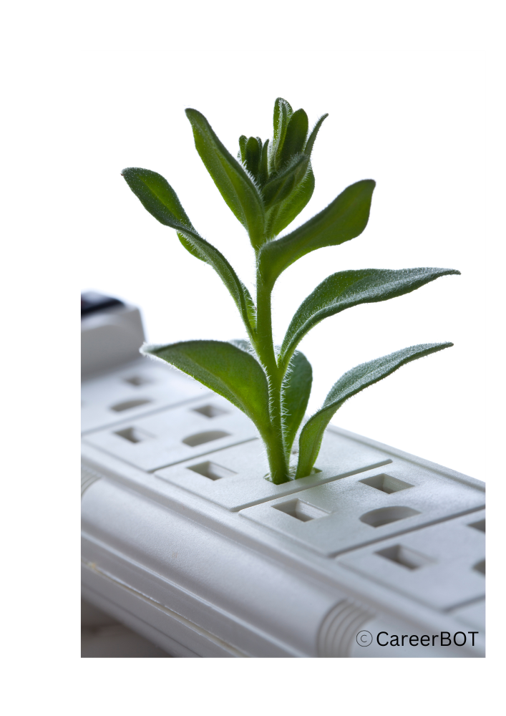
LU2: Benefits of the Green Deal
are summarised by the European Commission as follows:
Fresh air, clean water, healthy soil, and biodiversity
Renovated, energy-efficient buildings
Healthy and affordable food
Sustainable transport
New jobs and economic growth
European Commission. (2023). A European Green Deal. https://commission.europa.eu/strategy-and-policy/priorities-2019-2024/european-green-deal_en
Funded by the European Union. Views and opinions expressed are however those of the author(s) only and do not necessarily reflect those
of the European Union or OeAD-GmbH. Neither the European Union nor the granting authority can be held responsible for them.
Notes:
Learning Unit 2: Green Jobs in Europe: New Demands and Opportunities
By achieving these learning outcomes, participants will acquire a first insight in the green economy, EU green initiatives, and the role of green jobs in Europe's sustainable future. They will also better understand the skill requirements and initiatives aimed at bridging the skills gap in the context of green employment.
Understanding the Green Economy: Gain an in-depth understanding of Europe's role in the green economy and key initiatives like the European Green Deal, Circular Economy Action Plan, and Sustainable Finance Action Plan.
EU's Green Initiatives: Explore EU initiatives driving the green economy, such as the European Green Deal's climate goals, circular economy targets, and investments in sustainable tech.
Benefits of the European Green Deal: Discover the advantages of the European Green Deal, including improved environment, energy-efficient buildings, sustainable transport, and job creation.
Green Jobs in the Green Economy: Explore the significance of green jobs in energy, resource efficiency, and environmental protection, and their role in sustainable growth.
Future Skill Needs for Green Jobs: Examine skill requirements for green jobs, including technical, soft, and digital skills needed in renewable energy, circular economy, and more.
Addressing the Skills Gap: Learn how Europe tackles green job skill gaps, with a focus on initiatives like the Green Jobs for Youth Pact and educational efforts for young people.

Slide 24
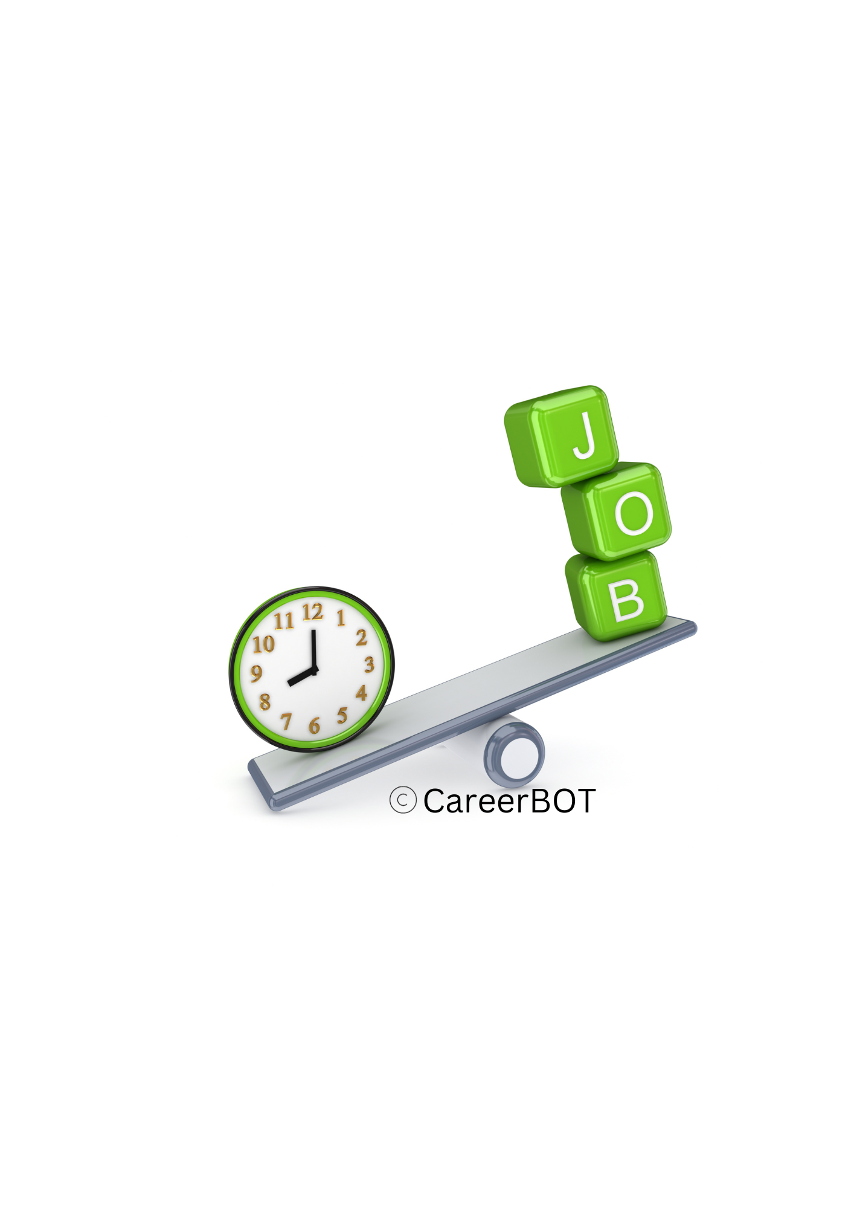
LU2: New Jobs in the Green Economy
The Potential of Green Jobs
The transition to a green economy has the potential to provide opportunities for job creation and sustainable economic growth. A greener economy could create 24 million new jobs globally by 2030 if the right policies are put in place. (International Labour Organization (ILO). 2023)
The new jobs will be created by
adopting sustainable practices in the energy sector, using electric vehicles, and increasing energy efficiency in existing and future buildings.
The circular economy, which involves reusing, repairing or recycling, increasing sustainable manufacturing and consumption, will also create green jobs.
See: United Nations Sustainable Development. (2019). Green economy could create 24 million new jobs. https://www.un.org/sustainabledevelopment/blog/2019/04/green-economy-could-create-24-million-new-jobs/
See: Iberdrola. (2020). What are Green Jobs and its impact on the economy. https://www.iberdrola.com/sustainability/what-are-green-jobs
Funded by the European Union. Views and opinions expressed are however those of the author(s) only and do not necessarily reflect those
of the European Union or OeAD-GmbH. Neither the European Union nor the granting authority can be held responsible for them.
Notes:
Learning Unit 2: Green Jobs in Europe: New Demands and Opportunities
By achieving these learning outcomes, participants will acquire a first insight in the green economy, EU green initiatives, and the role of green jobs in Europe's sustainable future. They will also better understand the skill requirements and initiatives aimed at bridging the skills gap in the context of green employment.
Understanding the Green Economy: Gain an in-depth understanding of Europe's role in the green economy and key initiatives like the European Green Deal, Circular Economy Action Plan, and Sustainable Finance Action Plan.
EU's Green Initiatives: Explore EU initiatives driving the green economy, such as the European Green Deal's climate goals, circular economy targets, and investments in sustainable tech.
Benefits of the European Green Deal: Discover the advantages of the European Green Deal, including improved environment, energy-efficient buildings, sustainable transport, and job creation.
Green Jobs in the Green Economy: Explore the significance of green jobs in energy, resource efficiency, and environmental protection, and their role in sustainable growth.
Future Skill Needs for Green Jobs: Examine skill requirements for green jobs, including technical, soft, and digital skills needed in renewable energy, circular economy, and more.
Addressing the Skills Gap: Learn how Europe tackles green job skill gaps, with a focus on initiatives like the Green Jobs for Youth Pact and educational efforts for young people.

Slide 25
LU2: Future Skill Needs for Green Jobs
The European Skills Agenda
aims to ensure that people develop the skills and competencies needed for the green and digital transitions. The European Skills Agenda is a five-year plan to help individuals and businesses develop more and better skills and to put them to use, by:
strengthening sustainable competitiveness, as set out in the European Green Deal
ensuring social fairness, putting into practice the first principle of the European Pillar of Social Rights: access to education, training and lifelong learning for everybody, everywhere in the EU
building resilience to react to crises, based on the lessons learnt during the COVID-19 pandemic
Website: https://ec.europa.eu/social/main.jsp?catId=1223&langId=en
Funded by the European Union. Views and opinions expressed are however those of the author(s) only and do not necessarily reflect those
of the European Union or OeAD-GmbH. Neither the European Union nor the granting authority can be held responsible for them.
Notes:
Learning Unit 2: Green Jobs in Europe: New Demands and Opportunities
By achieving these learning outcomes, participants will acquire a first insight in the green economy, EU green initiatives, and the role of green jobs in Europe's sustainable future. They will also better understand the skill requirements and initiatives aimed at bridging the skills gap in the context of green employment.
Understanding the Green Economy: Gain an in-depth understanding of Europe's role in the green economy and key initiatives like the European Green Deal, Circular Economy Action Plan, and Sustainable Finance Action Plan.
EU's Green Initiatives: Explore EU initiatives driving the green economy, such as the European Green Deal's climate goals, circular economy targets, and investments in sustainable tech.
Benefits of the European Green Deal: Discover the advantages of the European Green Deal, including improved environment, energy-efficient buildings, sustainable transport, and job creation.
Green Jobs in the Green Economy: Explore the significance of green jobs in energy, resource efficiency, and environmental protection, and their role in sustainable growth.
Future Skill Needs for Green Jobs: Examine skill requirements for green jobs, including technical, soft, and digital skills needed in renewable energy, circular economy, and more.
Addressing the Skills Gap: Learn how Europe tackles green job skill gaps, with a focus on initiatives like the Green Jobs for Youth Pact and educational efforts for young people.

Slide 26
LU2: Future Skill Needs for Green Jobs
In the research paper “Green jobs, definitional issues, and the employment of young people: An analysis of three European Union countries” Sulich (et al.) states that Green jobs can be a solution for young, unemployed people, not only offering them employment but also allowing them to become part of the solution to climate change (ScienceDirect. 2020).
An increasing emphasis on building the green economy provides excellent employment opportunities for young people seeking their first job.
However, young people with low education may face challenges in accessing green jobs.
Efforts to identify skill needs for jobs in a low-carbon economy have been taken most prominently by the regions.
The European Green Deal Skills Initiative aims to promote social fairness and inclusion by ensuring that all workers have access to the training and education they need to participate in the green economy. The practical responsibility for implementation now rests with the governments of the EU member states.
Funded by the European Union. Views and opinions expressed are however those of the author(s) only and do not necessarily reflect those
of the European Union or OeAD-GmbH. Neither the European Union nor the granting authority can be held responsible for them.
Notes:
Learning Unit 2: Green Jobs in Europe: New Demands and Opportunities
By achieving these learning outcomes, participants will acquire a first insight in the green economy, EU green initiatives, and the role of green jobs in Europe's sustainable future. They will also better understand the skill requirements and initiatives aimed at bridging the skills gap in the context of green employment.
Understanding the Green Economy: Gain an in-depth understanding of Europe's role in the green economy and key initiatives like the European Green Deal, Circular Economy Action Plan, and Sustainable Finance Action Plan.
EU's Green Initiatives: Explore EU initiatives driving the green economy, such as the European Green Deal's climate goals, circular economy targets, and investments in sustainable tech.
Benefits of the European Green Deal: Discover the advantages of the European Green Deal, including improved environment, energy-efficient buildings, sustainable transport, and job creation.
Green Jobs in the Green Economy: Explore the significance of green jobs in energy, resource efficiency, and environmental protection, and their role in sustainable growth.
Future Skill Needs for Green Jobs: Examine skill requirements for green jobs, including technical, soft, and digital skills needed in renewable energy, circular economy, and more.
Addressing the Skills Gap: Learn how Europe tackles green job skill gaps, with a focus on initiatives like the Green Jobs for Youth Pact and educational efforts for young people.

Slide 27
LU2: Addressing the Skills Gap
European countries are addressing the skills gap for green jobs among young people with low education in various ways. Here are some examples:
Launching initiatives to address the skills gap: The Green Jobs for Youth Pact, launched at COP27, aims to address the skills gap for green jobs among young people. Climate Action for Jobs. (2022). Launching the Green Jobs for Youth Pact at COP27. https://www.climateaction4jobs.org/launching-the-green-jobs-for-youth-pact-at-cop27/
The European Green Deal Skills Initiative is another initiative launched by the EU to provide upskilling and reskilling opportunities for workers in sectors affected by the green transition.. Cedefop. (2015). Future skill needs for the green economy. https://www.cedefop.europa.eu/files/5501_en.pdf
Providing education and training: Despite wanting jobs to combat climate change, young people do not understand enough about green skills.
Increasing awareness: Lack of awareness is another barrier to accessing green jobs among young people with low education. A global survey by Plan International found that only one in three young people feel competent in the skills they believe are needed to do jobs that tackle climate change. Cedefop. (2015). Future skill needs for the green economy. https://www.cedefop.europa.eu/files/5501_en.pdf
Emphasizing the potential of green jobs: Green jobs can be a solution for young, unemployed people, not only offering them employment but also allowing them to become part of the solution to climate change. ScienceDirect. (2020). Green jobs, definitional issues, and the employment of young people: An analysis of three European Union countries. https://www.sciencedirect.com/science/article/abs/pii/S0301479720302498
An increasing emphasis on building the green economy provides excellent employment opportunities for young people seeking their first job. See:Transition Europe. (2019). Green jobs in Europe and the increasing demand for technical skills. https://www.transition-europe.eu/fr/publication/green-jobs-europe-and-increasing-demand-technical-skills
Funded by the European Union. Views and opinions expressed are however those of the author(s) only and do not necessarily reflect those
of the European Union or OeAD-GmbH. Neither the European Union nor the granting authority can be held responsible for them.
Notes:
Learning Unit 2: Green Jobs in Europe: New Demands and Opportunities
By achieving these learning outcomes, participants will acquire a first insight in the green economy, EU green initiatives, and the role of green jobs in Europe's sustainable future. They will also better understand the skill requirements and initiatives aimed at bridging the skills gap in the context of green employment.
Understanding the Green Economy: Gain an in-depth understanding of Europe's role in the green economy and key initiatives like the European Green Deal, Circular Economy Action Plan, and Sustainable Finance Action Plan.
EU's Green Initiatives: Explore EU initiatives driving the green economy, such as the European Green Deal's climate goals, circular economy targets, and investments in sustainable tech.
Benefits of the European Green Deal: Discover the advantages of the European Green Deal, including improved environment, energy-efficient buildings, sustainable transport, and job creation.
Green Jobs in the Green Economy: Explore the significance of green jobs in energy, resource efficiency, and environmental protection, and their role in sustainable growth.
Future Skill Needs for Green Jobs: Examine skill requirements for green jobs, including technical, soft, and digital skills needed in renewable energy, circular economy, and more.
Addressing the Skills Gap: Learn how Europe tackles green job skill gaps, with a focus on initiatives like the Green Jobs for Youth Pact and educational efforts for young people.

Slide 28
LU2 Exercise: Green Jobs in your country
Objective: In this Learning Unit you have learned about key initiatives at the European level in this learning unit on the topic of green jobs in Europe. Now, it’s your turn to find initiatives in your country:
Check to see what initiatives are being implemented or have already been implemented in your country.
Make a note of those that seem most useful to you for working with your clients, and if you can, gather a good practise example.
Add your notes to your Learning Reflection during the training course.
Funded by the European Union. Views and opinions expressed are however those of the author(s) only and do not necessarily reflect those
of the European Union or OeAD-GmbH. Neither the European Union nor the granting authority can be held responsible for them.

Slide 29
Checklist: QUIZ “Green Jobs” in Europe
Please refer to the Word file on Module 1 – LU2
Find out what you learned in this Unit and let us know what we should improve.
Funded by the European Union. Views and opinions expressed are however those of the author(s) only and do not necessarily reflect those
of the European Union or OeAD-GmbH. Neither the European Union nor the granting authority can be held responsible for them.

Slide 30
Resources for M1-LU2:
The following learning material is provided:
M1-LU2-01 – PPT Presentation
M1-LU2-02 – Word file including:
Collection of Links
Videos and
Bibliography
Exercise: Green Jobs in your country
Checklist: QUIZ on “Green Jobs” in Europe
Funded by the European Union. Views and opinions expressed are however those of the author(s) only and do not necessarily reflect those
of the European Union or OeAD-GmbH. Neither the European Union nor the granting authority can be held responsible for them.

Slide 31
Let‘s stay connected!
CareerBot
Chatbot based Career Guidance
Project leader and coordinator
Hafelekar
Project duration
November 2021 to August 2024
Programme
Erasmus+ Strategic Partnership
WEB
https://careerbot.eu
Contact
info@hafelekar.at
PARTNER
Hafelekar Unternehmensberatung, AT
Tiroler Soziale Dienste GmbH, AT
Synergasia Enegon Politon, GR
Pontydysgu SL, ES
Consultoría de Innovación Social, ES
Ballymun Job Centre Co-operative Society Limited, IE
Web: https://careerbot.eu
Videos: https://www.youtube.com/@career-bot
LinkedIn: www.linkedin.com/company/eucareerbot
Training online: https://careerbot.eu/training
CC BY-NC-ND
This document is licensed under CC BY-NC-ND. See: https://creativecommons.org/licenses/by-nc-nd/4.0/
Funded by the European Union. Views and opinions expressed are however those of the author(s) only and do not necessarily reflect those of the European Union or OeAD-GmbH. Neither the European Union nor the granting authority can be held responsible for them.

